Slide 1
"House Price Prediction Project”
Using SQL

Slide 2
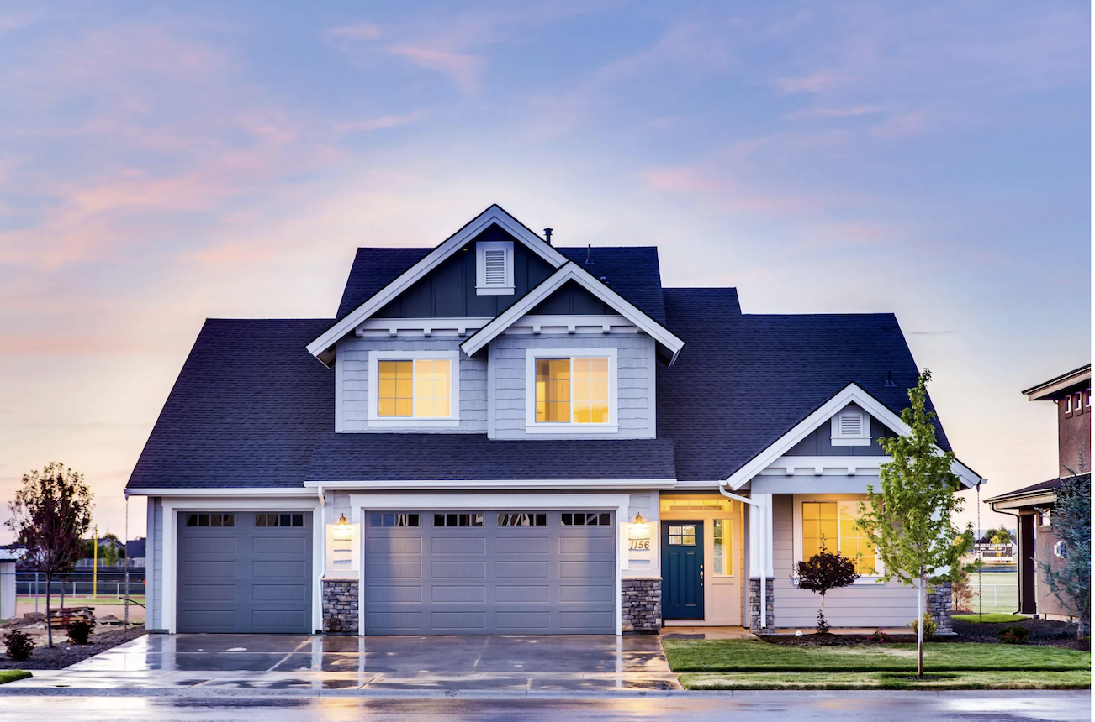

Slide 3
Objective of the Project:
To analyze and predict house prices based on various factors such as area, number of bedrooms, bathrooms, presence of amenities (like a basement, air conditioning, etc.), and location features (such as being on a main road or in a preferred area). This project aims to identify key variables that significantly impact house prices and provide insights into the real estate market trends.

Slide 4
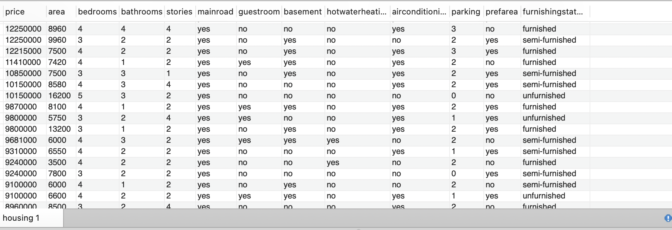
Data Exploration:

Slide 5
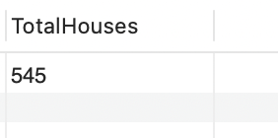
View the total number of records:

Slide 6
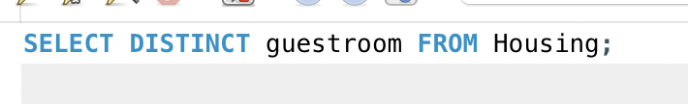
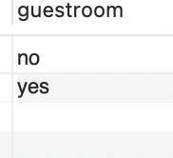
Guest Room:

Slide 7

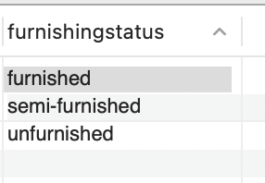
Furnishing Status:

Slide 8
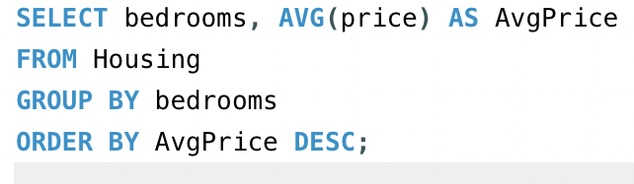
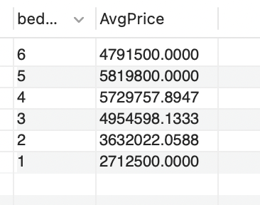
Aggregation and Summary Statistics:
Average price of houses by the number of bedrooms:

Slide 9
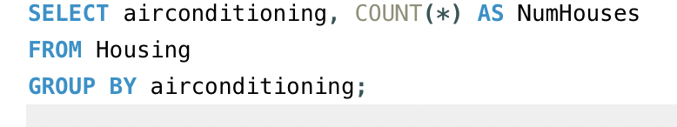
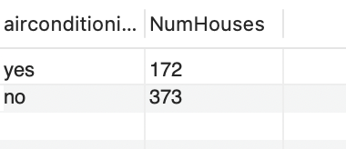
Count of houses with and without air conditioning:

Slide 10
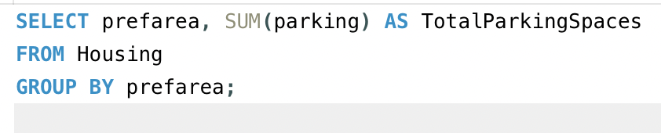
Total parking spaces available by neighborhood preference area:

Slide 11
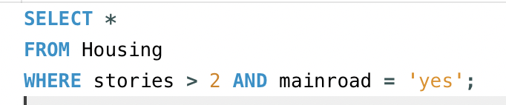
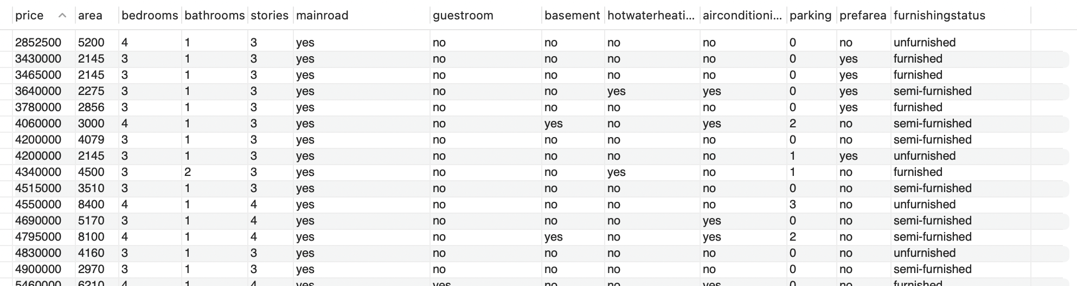
Filtering Data:
1.Houses with more than 2 stories and located on the main road:

Slide 12
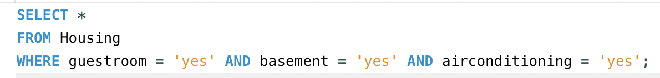
2. Houses with a guestroom, basement, and air conditioning:

Slide 13
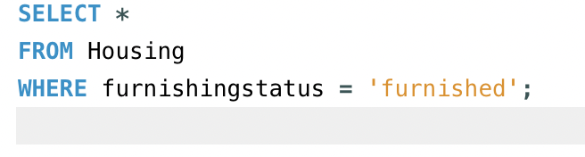
3.Houses with a specific furnishing status:

Slide 14
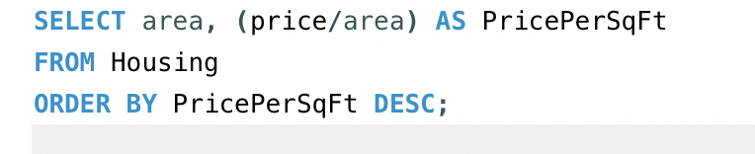
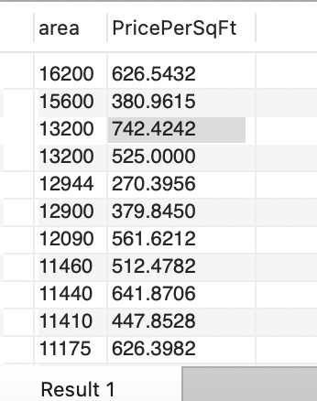
. Advanced Analysis:
Average price per square foot of area:

Slide 15
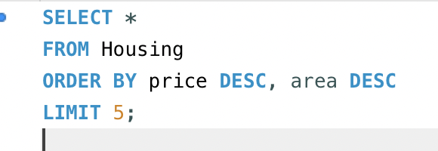
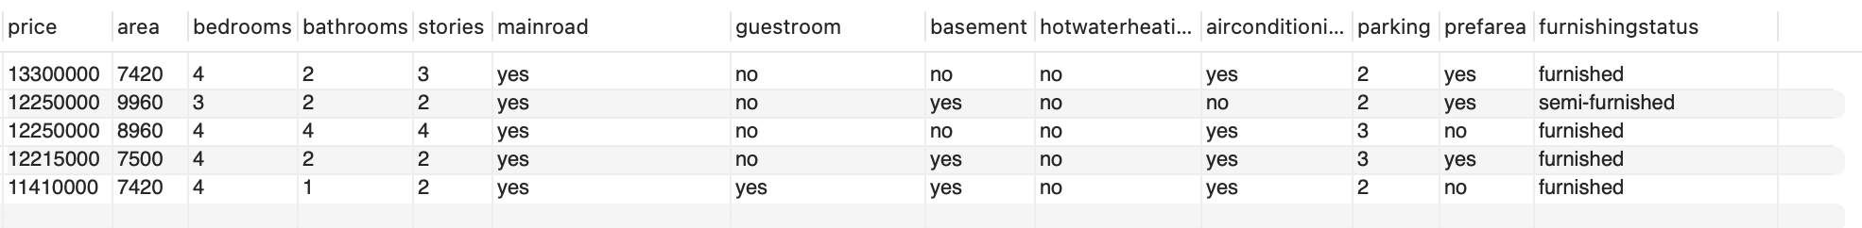
Average price per square foot of area:

Slide 16
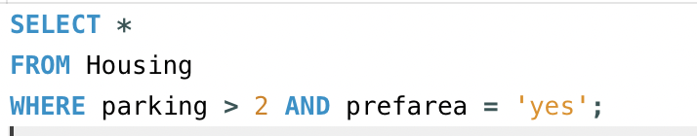
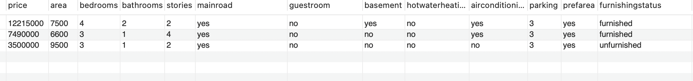
3.Houses with parking more than 2 spaces and preferred area:

Slide 17
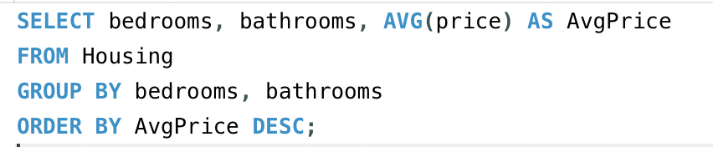
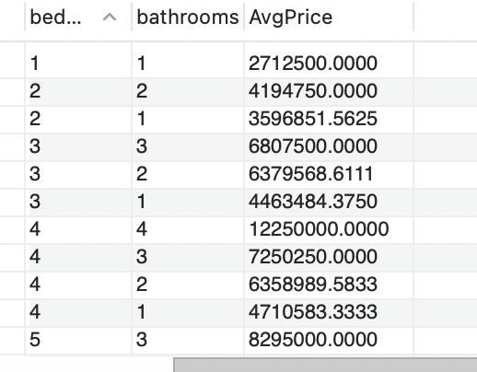
Predictive Queries:
1.Estimate the average price based on the number of bedrooms and bathrooms:

Slide 19
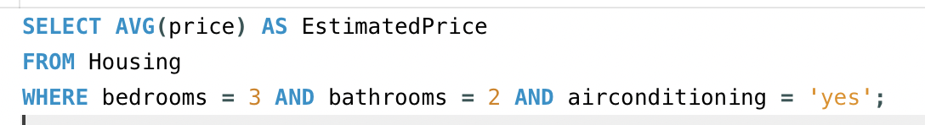
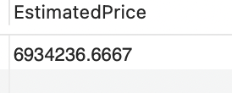
Predicting the price of houses with certain features (e.g., 3 bedrooms, 2 bathrooms, and air conditioning):

